Slide 1
MATHEMATICAL FOUNDATION FOR COMPUTER SCIENCE
Prepared by: Er. Ankit Kharel
Nepal college of information technology

Slide 2
Finite state automata
• Sequential Circuits and Finite state Machine
• Finite State Automata
• Non-deterministic Finite State Automata
• Language and Grammars
• Language and Automata
• Regular Expression

Slide 3

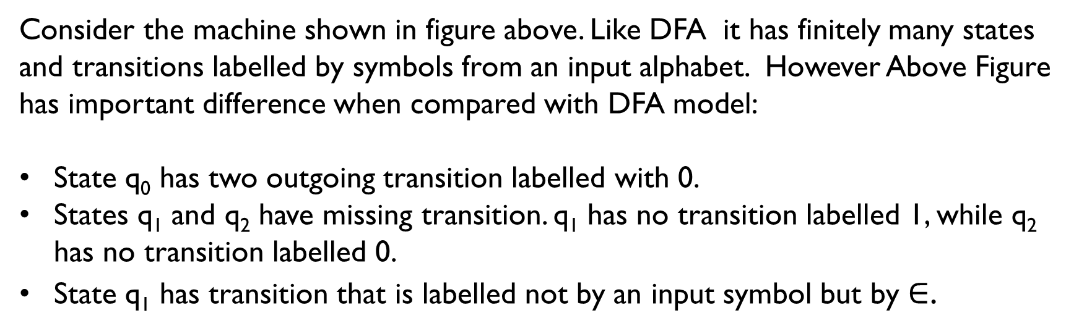
Non-Deterministic Finite state Automata(nFA):
0
0 , 1
0 , 1
q₀
0
1
q₃
q₁
$$∈$$
q₂
Consider the machine shown in figure above. Like DFA it has finitely many states and transitions labelled by symbols from an input alphabet. However Above Figure has important difference when compared with DFA model:
State q₀ has two outgoing transition labelled with 0.
States q₁ and q₂ have missing transition. q₁ has no transition labelled 1, while q₂ has no transition labelled 0.
State q₁ has transition that is labelled not by an input symbol but by $∈$.

Slide 4
Non-Deterministic Finite state Automata(nFA):
Key Difference Between NFA and DFA:
An NFA can have multiple transitions for a symbol from the same state but DFA can only have one transition for each symbol.
An NFA is not required to have a transition for each symbol where as for DFA there should be transition for each symbol.
NFA can have a transition for an empty string where as DFA cannot transition on empty string.

Slide 5
Formal definition of NFA:
A NFA , N is a quin – Tuple( 5 Tuple ) defined as,
N = {I, S, f, σ, A} where,
I is the set of input symbols
S is the set of finite states
σ is an initial state
A is the final accepting state
f:S*I→2^{s} is the next state transition function
A string ‘w’ is said to be accepted by NFA if there exist at least one transition path on which we start and ends at final state.
Every DFA is NFA and every NFA can be converted to DFA.
Power of Both DFA and NFA is same.

Slide 6
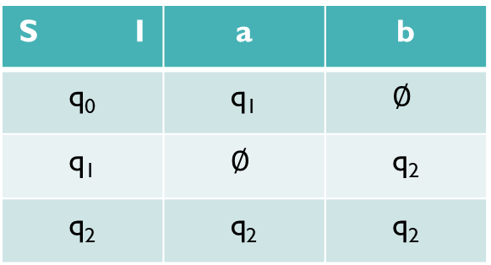
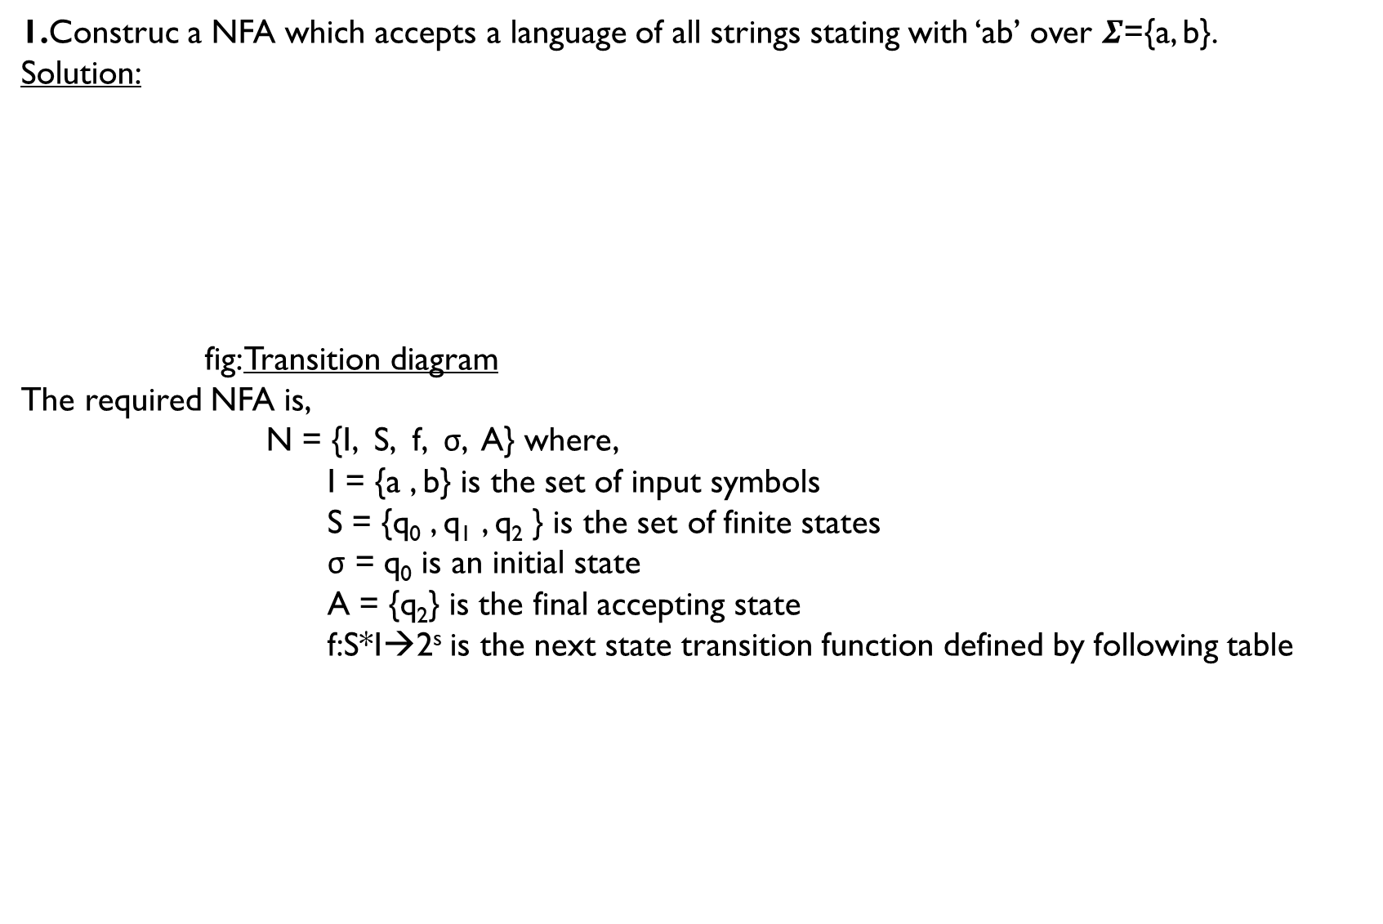
1.Construc a NFA which accepts a language of all strings stating with ‘ab’ over $Σ$={a, b}.
Solution:
fig: Transition diagram
The required NFA is,
N = {I, S, f, σ, A} where,
I = {a , b} is the set of input symbols
S = {q₀ , q₁ , q₂ } is the set of finite states
σ = q₀ is an initial state
A = {q₂} is the final accepting state
f:S*I→2^{s} is the next state transition function defined by following table
a , b
a
b
q₂
q₀
q₁
S I | a | b
q₀ | q₁ | $$∅$$
q₁ | $$∅$$ | q₂
q₂ | q₂ | q₂

Slide 7
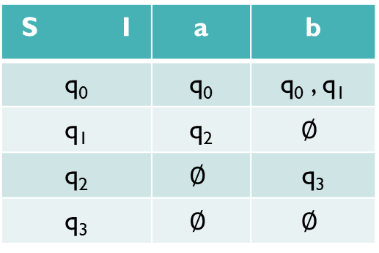
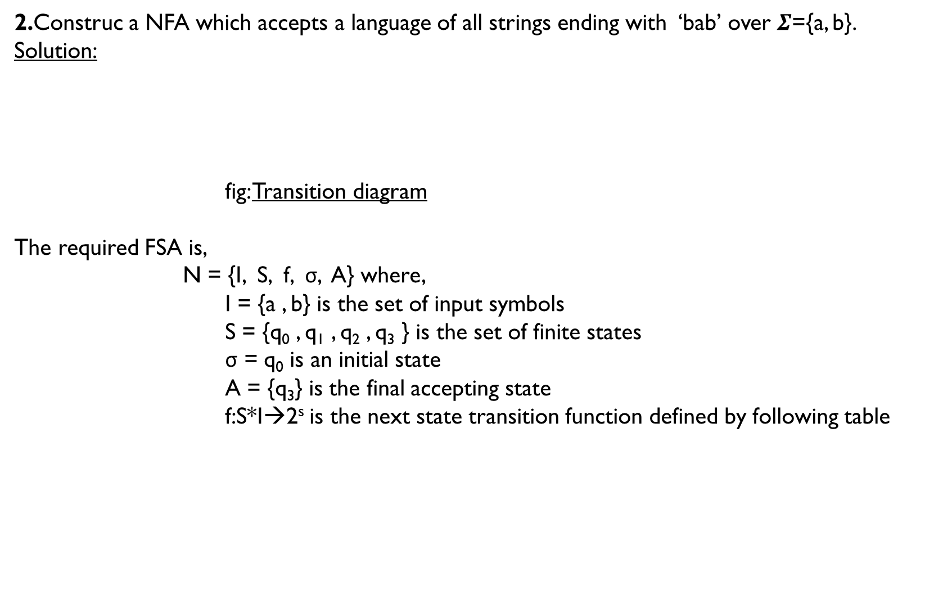
2.Construc a NFA which accepts a language of all strings ending with ‘bab’ over $Σ$={a, b}.
Solution:
fig: Transition diagram
The required FSA is,
N = {I, S, f, σ, A} where,
I = {a , b} is the set of input symbols
S = {q₀ , q₁ , q₂ , q₃ } is the set of finite states
σ = q₀ is an initial state
A = {q₃} is the final accepting state
f:S*I→2^{s} is the next state transition function defined by following table
a
b
q₁
a
q₂
b
q₃
q₀
b
S I | a | b
q₀ | q₀ | q₀ , q₁
q₁ | q₂ | $$∅$$
q₂ | $$∅$$ | q₃
q₃ | $$∅$$ | $$∅$$

Slide 8
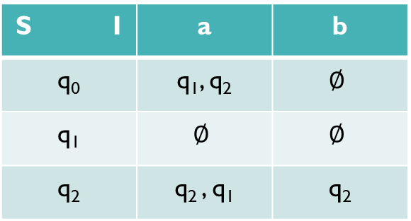
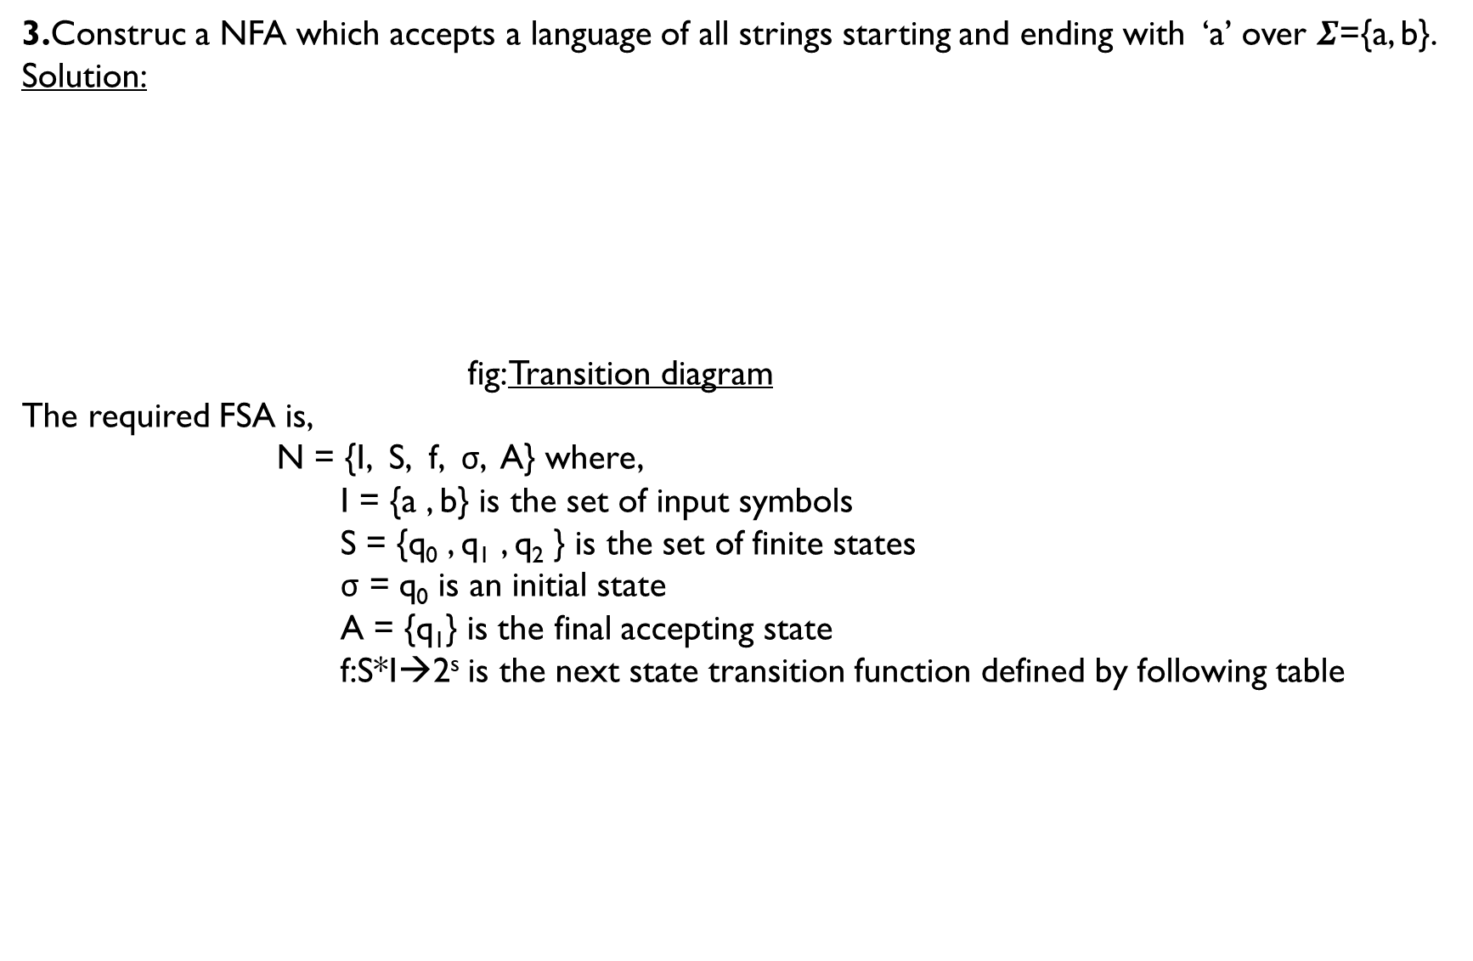
3.Construc a NFA which accepts a language of all strings starting and ending with ‘a’ over $Σ$={a, b}.
Solution:
fig: Transition diagram
The required FSA is,
N = {I, S, f, σ, A} where,
I = {a , b} is the set of input symbols
S = {q₀ , q₁ , q₂ } is the set of finite states
σ = q₀ is an initial state
A = {q₁} is the final accepting state
f:S*I→2^{s} is the next state transition function defined by following table
q₀
a
q₁
a
q₂
a
a, b
S I | a | b
q₀ | q₁, q₂ | $$∅$$
q₁ | $$∅$$ | $$∅$$
q₂ | q₂ , q₁ | q₂

Slide 9
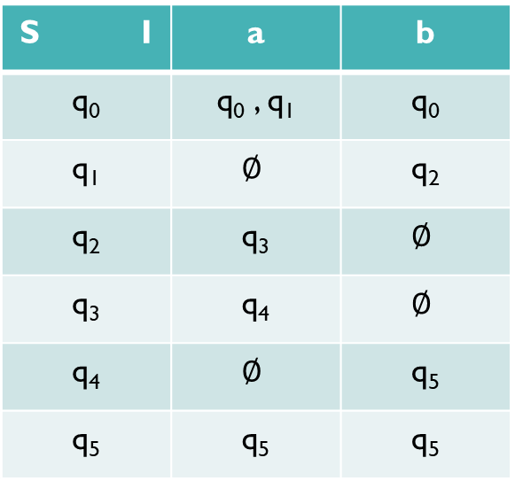

4.Construc a NFA which accepts a language of all strings containing substring ‘abaab’ over $Σ$={a, b}.
Solution:
fig: Transition diagram
The required FSA is,
N = {I, S, f, σ, A} where,
I = {a , b} is the set of input symbols
S = {q₀ , q₁ , q₂ , q₃ , q₄ , q₅ } is the set of finite states
σ = q₀ is an initial state
A = {q₅} is the final accepting state
f:S*I→2^{s} is the next state transition function
defined by following table
a, b
a , b
q₀
a
b
q₂
a
q₃
a
q₄
b
q₅
q₁
S I | a | b
q₀ | q₀ , q₁ | q₀
q₁ | $$∅$$ | q₂
q₂ | q₃ | $$∅$$
q₃ | q₄ | $$∅$$
q₄ | $$∅$$ | q₅
q₅ | q₅ | q₅

Slide 10
Conversion of NFA to DFA:
We use subset construction method:
Construct a transition table of given NFA.
Identify all the new states from the transition table and find the transition for each new state in term of input symbols.
This process is continued until transaction for all the new states are identified.
Finally, draw a transition diagram by using all the states obtained.

Slide 11
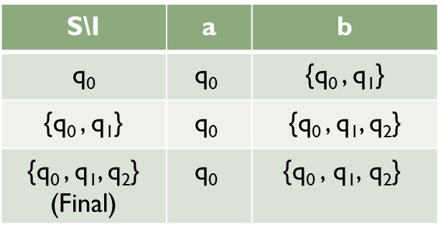
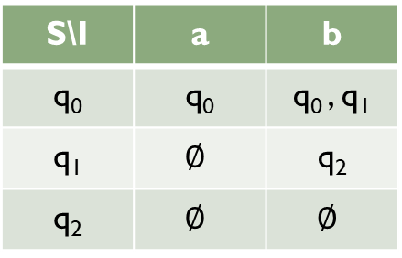
Convert the following NFA to DFA:
Solution:
Transition table for NFA: b. Identifying new states and transition for DFA:
a , b
b
b
q₂
q₀
q₁
S\I | a | b
q₀ | q₀ | q₀ , q₁
q₁ | $$∅$$ | q₂
q₂ | $$∅$$ | $$∅$$
S\I | a | b
q₀ | $$\text{q}\text{0}$$ | {q₀ , q₁}
{q₀ , q₁} | $$\text{q}\text{0}$$ | {q₀ , q₁, q₂}
{q₀ , q₁, q₂} (Final) | $$\text{q}\text{0}$$ | $$\text{\{}\text{q}\text{0 }\text{, }\text{q}\text{1}\text{, }\text{q}\text{2}\text{\}}$$
a
a
b
b
b
{q₀ , q₁, q₂}
q₀
{q₀ , q₁}
a

Slide 12
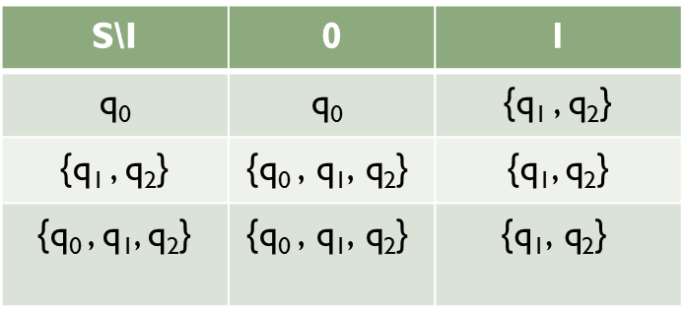
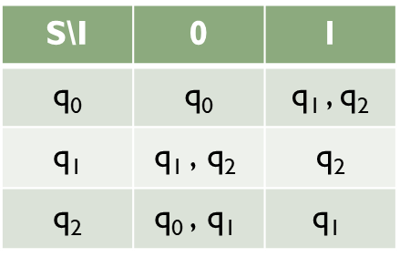
2. Convert the following NFA to DFA:
Solution:
Transition table for NFA: b. Identifying new states and transition for DFA:
q₀
1
q₁
0
0
1
0, 1
q₂
0, 1
0
S\I | 0 | 1
q₀ | q₀ | q₁ , q₂
q₁ | $$\text{q}\text{1 }\text{, }\text{q}\text{2}$$ | q₂
q₂ | $$\text{q}\text{0} \text{, }\text{q}\text{1}$$ | $$\text{q}\text{1}$$
S\I | 0 | 1
q₀ | $$\text{q}\text{0}$$ | {q₁ , q₂}
{q₁ , q₂} | $$\text{\{}\text{q}\text{0 }\text{, }\text{q}\text{1}\text{, }\text{q}\text{2}\text{\}}$$ | {q₁, q₂}
{q₀ , q₁, q₂} | $$\text{\{}\text{q}\text{0 }\text{, }\text{q}\text{1}\text{, }\text{q}\text{2}\text{\}}$$ | $$\text{\{}\text{q}\text{1}\text{, }\text{q}\text{2}\text{\}}$$
0
1
0
1
0
{q₀ , q₁, q₂}
q₀
{q₁ , q₂}
1

Slide 13
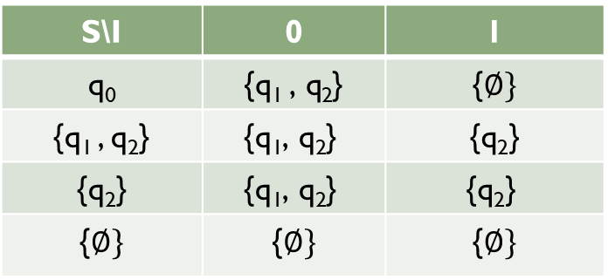
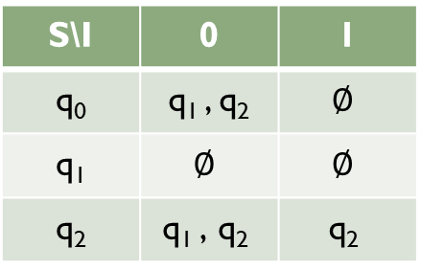

3. Convert the following NFA to DFA:
Transition table for NFA: b. Identifying new states and transition for DFA:
q₀
0
q₁
q₂
0
0
0, 1
S\I | 0 | 1
q₀ | q₁ , q₂ | $$∅$$
q₁ | $$∅$$ | $$∅$$
q₂ | $$\text{q}\text{1} \text{, }\text{q}\text{2}$$ | $$\text{q}\text{2}$$
S\I | 0 | 1
q₀ | {$\text{q}\text{1 }\text{, }\text{q}\text{2}$} | {$∅\}$
{q₁ , q₂} | $$\text{\{}\text{q}\text{1}\text{, }\text{q}\text{2}\text{\}}$$ | {q₂}
{q₂} | $$\text{\{}\text{q}\text{1}\text{, }\text{q}\text{2}\text{\}}$$ | $$\text{\{}\text{q}\text{2}\text{\}}$$
{$∅\}$ | {$∅\}$ | {$∅\}$
0
0
1
1
q₀
{q₁ , q₂}
{q₂}
1
{$∅\}$
0,1
0

Slide 14
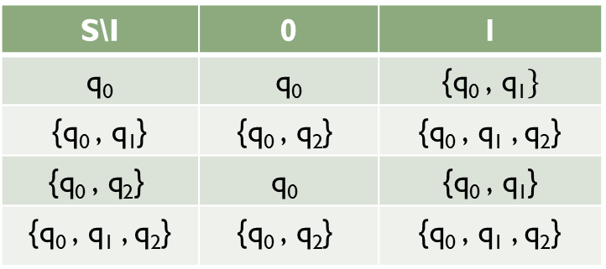
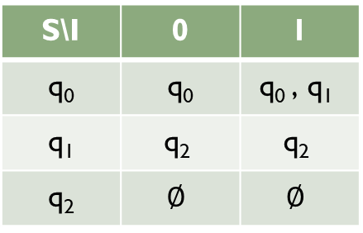


4. Convert the following NFA That accepts all string in which second last bit is 1.
Transition table for NFA: b. Identifying new states and transition for DFA:
q₀
1
q₁
0, 1
q₂
0, 1
S\I | 0 | 1
q₀ | q₀ | $$\text{q}\text{0} \text{, }\text{q}\text{1}$$
q₁ | $$\text{q}\text{2}$$ | $$\text{q}\text{2}$$
q₂ | $$∅$$ | $$∅$$
1
S\I | 0 | 1
q₀ | q₀ | {$\text{q}\text{0} \text{, }\text{q}\text{1}\}$
{$\text{q}\text{0} \text{, }\text{q}\text{1}$} | $$\text{\{}\text{q}\text{0} \text{, }\text{q}\text{2}\text{\}}$$ | {$\text{q}\text{0} \text{, }\text{q}\text{1}$ , q₂}
$$\text{\{}\text{q}\text{0} \text{, }\text{q}\text{2}\text{\}}$$ | $$\text{q}\text{0}$$ | {$\text{q}\text{0} \text{, }\text{q}\text{1}$}
{$\text{q}\text{0} \text{, }\text{q}\text{1}$ , q₂} | $$\text{\{}\text{q}\text{0} \text{, }\text{q}\text{2}\text{\}}$$ | {$\text{q}\text{0} \text{, }\text{q}\text{1}$ , q₂}
$$\text{\{}\text{q}\text{0 }\text{, }\text{q}\text{1}\text{, }\text{q}\text{2}\text{\}}$$
1
0
0
1
0
q₀
{q₀ , q₁}
$$\text{\{}\text{q}\text{0 }\text{, }\text{q}\text{2}\text{\}}$$
1
0

